Slide 1
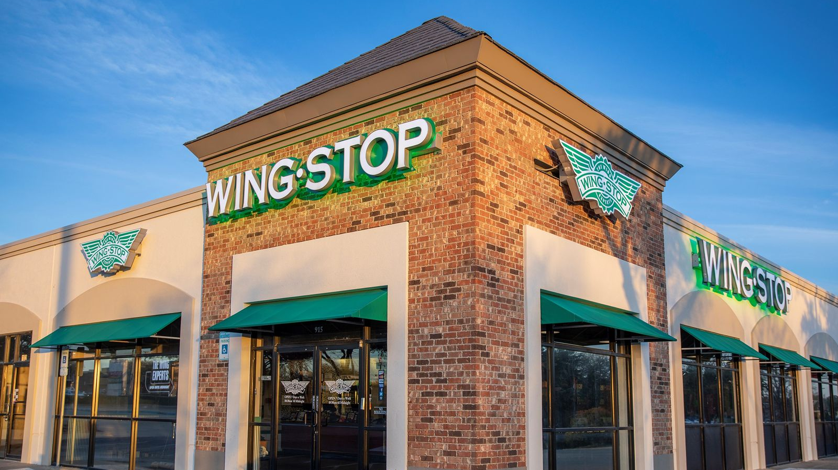
Wingstop
STOCK ANALYSIS
GROUP 8 – Parth Parker, Shields Riggs, Brendon Matsikinya, Rhys Nordstrom

Slide 2
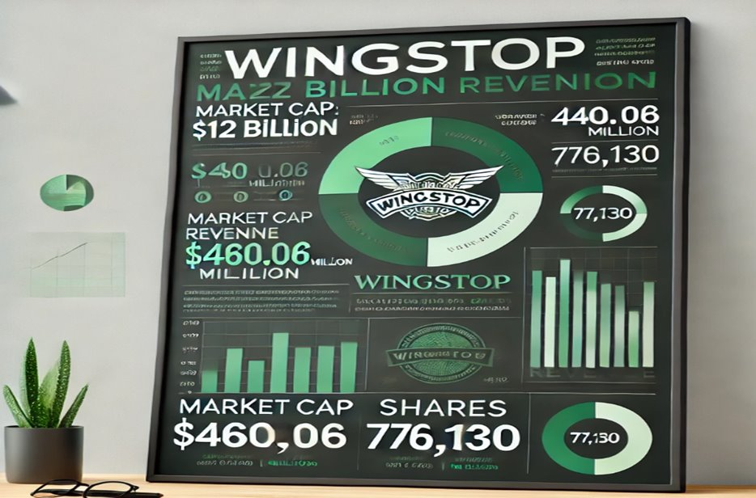
BUSINESS MODEL & strategy
Company Overview
•Founded in 1994, in Garland, Texas, USA
•Founder: Antonio Swad & Bernadette Fiaschetti
•Over 2,000 stores in more than 12 countries.
•Specializing in quick service chicken wings and fries.
Core Information
•Publicly Traded: Listed on NASDAQ in 2015 under the ticker WING.
•Business Model: Over 98% of Wingstop restaurants are franchised.

Slide 3
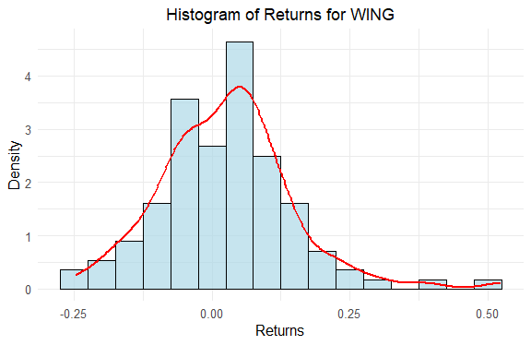
DISTRIBUTION OF MONTHLY RETURNS
WINGS Standard Deviation: 12%
WINGS Mean Return/Month: 2.6%
MCD Standard Deviation: 5.9%
MCD Mean Return/Month: 1.2%

Slide 4

BASE, bear, and BULL CASE
0%: $406.32 25%: $6,551.50 50%: $13,887.46 75%: $30,937.80 100%: $1,257,917.95

Slide 5
Potential Growth and Risks
AREAS FOR FUTURE GROWTH
POTENTIAL RISKS & CHALLENGES
Signature Offerings & Products
New Locations
Brand Awareness
Food Cost
Varying Performance
Expansion

Slide 6
WORKS CITED
Wingstop – Wikipedia
Wingstop (WING) Stock Price, News & Info | The Motley Fool
Wingstop Inc (WING) Soars with Record Sales and Net Income Growth in 2023 (yahoo.com)
Wingstop serves up two-year same-store sales of more than 45% (restaurantbusinessonline.com)
Wingstop outpaces fast-food competitors (cnbc.com)

